Slide 1

CSoNet 2023
The 12th International Conference on Computational Data and Social Networks
National Economics University (NEU) Hanoi, Vietnam
University of Information Technology - VNUHCM
MIDAS: A Multi-chain Interoperable Data and Access System for Healthcare
Ngan Nguyen Bui Kim
Nguyen Binh Thuc Tram
Tuan-Dung Tran Phan The Duy Van-Hau Pham
Notes:
Hello every one, I’m Nguyễn Bình Thục Trâm, a student from the University of Information Technology. Joining me is my collaborator, Ms. Nguyen Bui Kim Ngan.
Today, we're excited to share our research project titled "MIDAS: A Multi-chain Interoperable Data and Access System for Healthcare."

Slide 2
Table of contents
01
02
03
04
Introduction
Proposed system
Implementation
Conclusion
Notes:
Our presentation will be divided into four main parts:
Intro: In this section, we will provide an overview of the current challenges in Healthcare Data Management; Significance of blockchain, also crosschain technology in addressing those challenges and basic concept of Decentralized Identifiers. Importantly, we will outline the key motivations behind our proposed system and discuss about the research objectives in our study.
Pro sys: Here, we will delve into the core of our research, present a detailed explanation of the proposed system for cross-chain data transfer and blockchain entities management using our decentralized Identifiers scheme, the most important component in our framework.
Impl: This section will offer insights into the practical implementation of our proposed system, include Experimental environment info, various scenarios for performance testing, experimental results.
Conclusion: Lastly, we will conclude our presentation by summarizing the key contributions of our study and discuss about future works

Slide 3
01
Introduction
CSoNet 2023

Slide 4
Healthcare sector
1
2
3
4
5
Managing extensive sensitive patient data, struggles with effective medical data management.
Fragmented data
Security vulnerabilities
Limited accessibility
BLOCKCHAIN TECHNOLOGY
Traditional healthcare systems
Security
Data integrity
Patient empowerment
Lack of patient engagement
Interoperability issues
Regulatory compliance challenges
Remote accessibility
Notes:
The healthcare sector, dealing with a vast amount of sensitive patient data, has always faced difficulties in handling and organizing information. Traditional systems often fall short in providing the necessary security and transparency required for the management of medical information. They usually have some common weakness like …
Recently, blockchain technology has become a promising solution to tackle the challenges in healthcare data management. Blockchain, renowned for its decentralized and immutable nature, holds the potential to significantly transform healthcare data management by ensuring secure, integrity, bring Patient Empowerment (allows patients to have more control over their health data), Remote accessibility (enables decentralized and secure access to patient records.)
However, integrating blockchain into healthcare is not without its hurdles. Privacy concerns, regulatory compliance, and multi-blockchain networks complexities.

Slide 5
Blockchain in healthcare
1
2
3
4
5
Challenges
Hospitals have embraced blockchain networks for managing personnel, patients, and Electronic Medical Records (EMRs).
Cross-chain data transfer problem
EMRs are scattered across diverse blockchain systems in different hospitals
Challenge of locating and identifying these records
Cross-chain solution
Decentralized identifiers
Notes:
… and patient may visit many hospitals leading to have multiple EMRs in different places
So we have to face some challenges such as:
… when the doctor want to access to existed EMRs of patient
, posing difficulties in data linkage and management of extensive information and …
these challenges are our main motivation to research efficient cross-chain solutions and Decentralized identifiers system is suitable with multi-chain domain

Slide 6
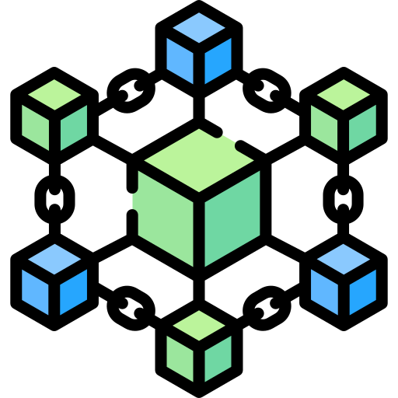
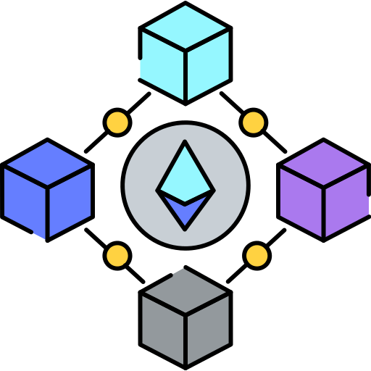
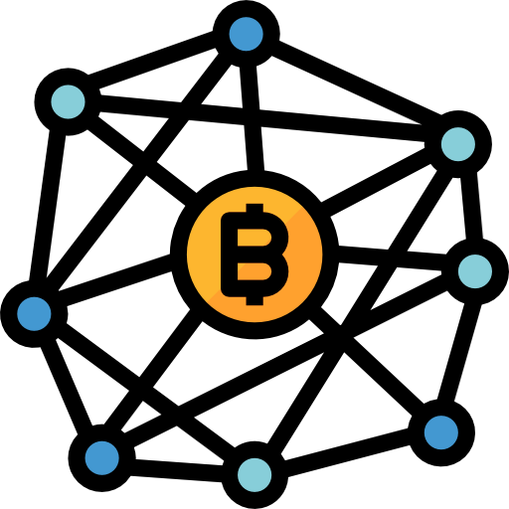
Sidechain
1
2
3
4
5
Cross-chain solution: a separate blockchain that runs in parallel, allows transferring data or asset between distinct blockchains
SIDECHAIN
Notes:
So, I’ll introduce the concept of sidechain
Parallel to the main blockchains
Next, I will discuss the details of sidechain architecture in the proposed system

Slide 7
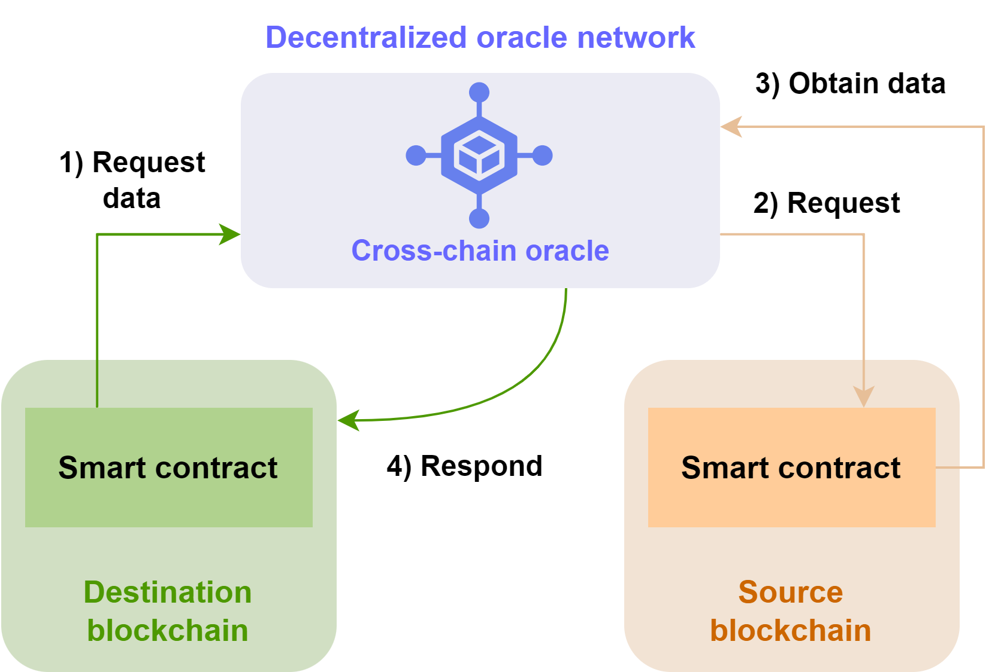
Our sidechain architecture
1
2
3
4
5
is a decentralized oracle network
Oracles
Serve as bridges between blockchains and the real world, retrieve external data into the blockchain and enable the seamless transmission of internal blockchain data to the external world.
In sidechain
Each oracle receives data requests from user, enables the oracle contract to create the secure communication and transfer of external data to and from the blockchain network.
Notes:
So, I’ll introduce the concept of sidechain
Parallel to the main blockchains
Next, I will discuss the details of sidechain architecture in the proposed system

Slide 8

Decentralized identity
1
2
3
4
5
Identity management systems are often centralized, lead to user dependency and privacy concerns.
no central authority and eliminate single point failure in identifier management
Decentralization
Key features
created by individual, organization without depending on third party
Ownership
users have full control, enhancing privacy and consent
Control
designed to be globally unique using cryptographic techniques
Uniqueness
Notes:
Contemporary Identity management systems often employ a centralized model, wherein specific organizations assume responsibility for issuing and managing user IDs, resulting in user dependency and limited control over identity data. This leaves personal information exposed and puts user privacy at risk
This is where Decentralized Identifiers come into play. They are a new way of managing and verifying digital identities in a decentralized manner.
Let’s look into some key features of DIDs

Slide 9
02
Proposed system
CSoNet 2023

Slide 10
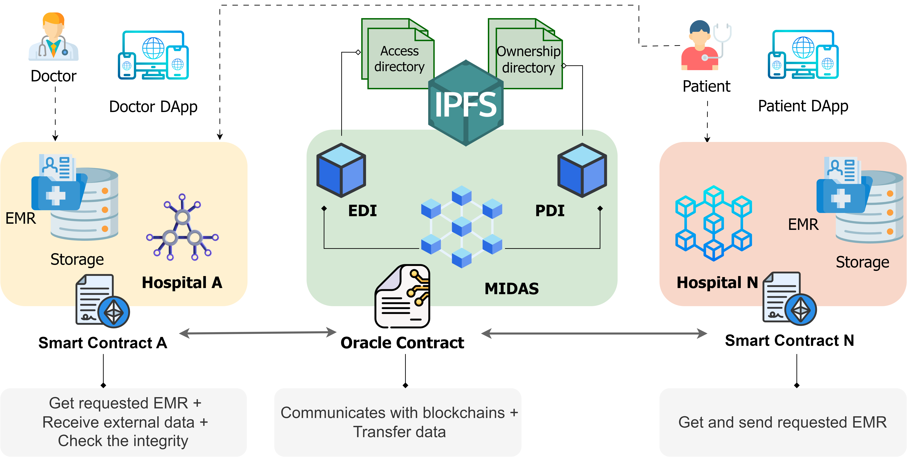
Overview diagram
1
2
3
4
5
Notes:
In there, the system have key components as follows:
Hospital A, Hospital N and MIDAS acts as a Sidechain
In Hospital A, we have Doctor Patient and EMR of patient
In Hospital N, we have Patient and EMR of patient
The most important component, MIDAS, is an intermediary between two blockchain, also serves as the repository for BIDIs – our novel Decentralized identifiers scheme, I’ll talk about it later.
MIDAS is integrated with IPFS to store some dynamic datasets called BIDI directory

Slide 11
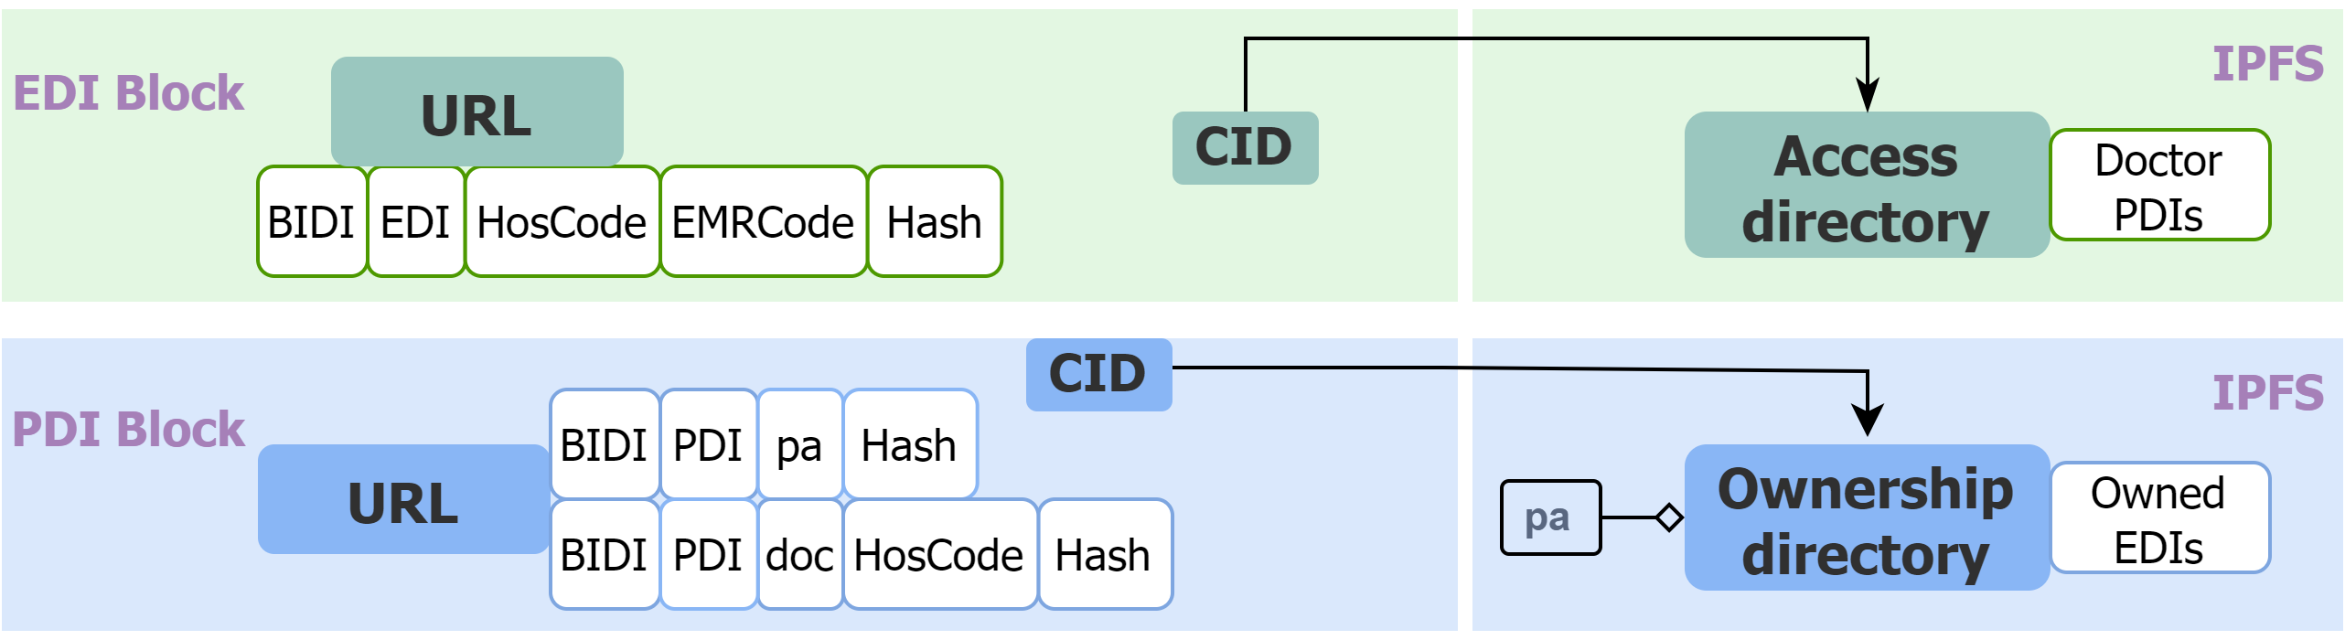
BIDI structures (1/2)
1
2
3
4
5
BIDI - Blockchain Interoperability Decentralized Identifier
URL-based identifier
Prefix
Types
Path
bidi/pdi/pa/0xd1809df8c38d12b8287a02169e75a56fdb1b76394c1890e3472b797a3d8ba9bd
Notes:
BIDI is designed to identity provisioning and enable smooth interactions between different blockchain networks. Each participant in this system, including Doctors, Patients, and EMRs, have a distinct URL-based identifier. Essential components of the URL-based identifier are as illustrated in this figure.
First is The prefix named BIDI and following it is types of BIDI encompassing EDI used for EMR and PDI used for person.
Next is Specific Identifier Path and its structure is contingent upon Type of BIDI and Role in case of PDI.
With EDI type, it comprises the following components: HosCode, signifying the unique identifier of the hospital to which the EMR is affiliated; EMRCode, representing the distinctive EMR code; and Hash string
With PDI type, including roles such as doctor or patient. Additionally, HosCode is included if the role is doctor, signifying the hospital to where they belong. Finally, a Hash string, calculated from the Public and Private key pair.

Slide 12
BIDI structures (2/2)
1
2
3
4
5
BIDI - Blockchain Interoperability Decentralized Identifier
BIDI directory
ADir
ODir
PaPDI
DocPDI
DocPDI
DocPDI
EDI
EDI
EDI
EDI
Notes:
BIDI directory is a dataset designed to encompass predefined information crucial for establishing data linkage management and automated data access control. It is linked to URLs associated with the same BIDI, with different types of BIDI having their distinct directory variants.
For EDI-type BIDIs, each possesses an Access directory, contains PDIs, with the top and mandatory PDI corresponding to the URL of the patient who is the rightful owner of the corresponding EMR. Subsequent PDIs pertain to doctors sharing the same HosCode as the EDI, granting them seamless access automatically to the EMR with owner’s consent.
For PDI-type BIDIs, lies a comprehensive record of EDIs corresponding to EMRs owned by the patient, creating links between data entities and expediting data retrieval

Slide 13
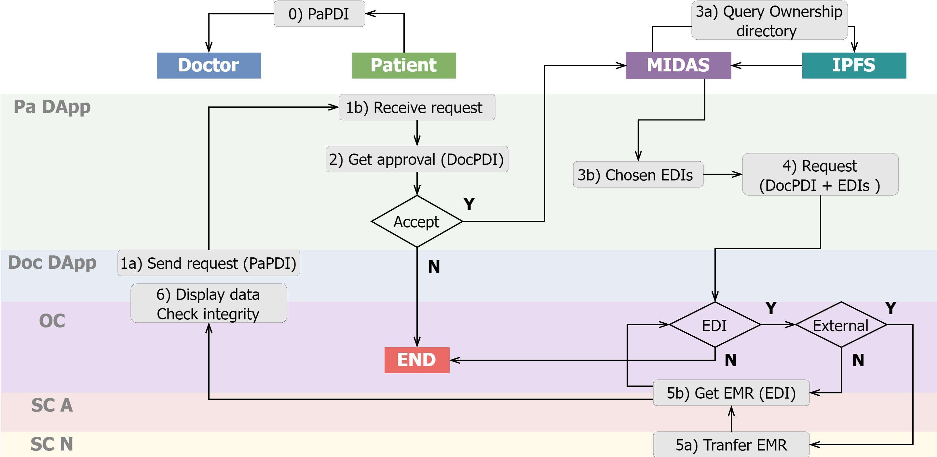
Access request processing flows
1
2
3
4
5
Notes:
This figure depicts data transfer activities within the system. The process of a Doctor sending access requests to a patient's existing EMRs unfolds as follows:
Step 0) Doctor first obtains the patient PDI
Step 1) Via the Doc DApp, Doctor specifies PaPDI and sends a data access request to DApp of patient.
Step 2) Get the approval
Step 3) PaDApp retrieve the corresponding Ownership directory on IPFS. It compiles a list of EDIs from which the patient selects EMRs to share with the Doctor
Step 4) Create a query request and sends it to MIDAS
Step 5) Check EDI quantity, HosCode and then get the requested data
Step 6) Display EMRs to the Doctor and data integrity can be verified through URL hash string. The operation subsequently reverts to step 5

Slide 14
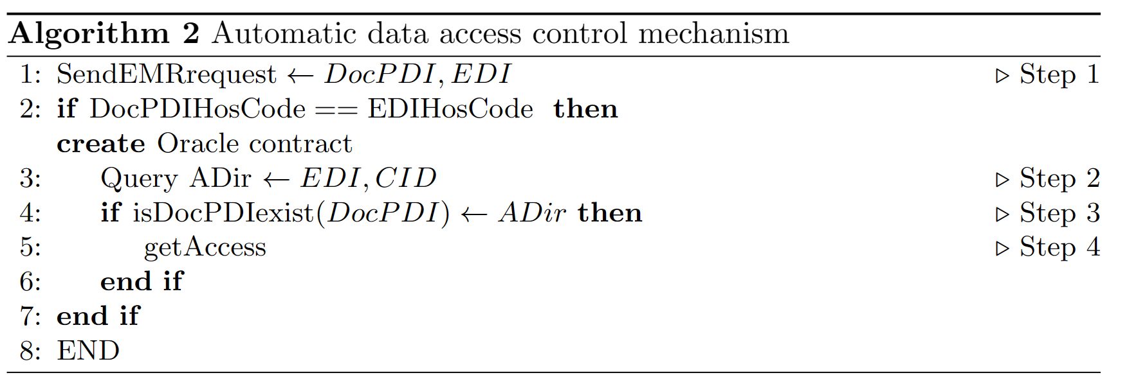
Automatic data access control mechanism
1
2
3
4
5
Notes:
Final is Automatic data access control mechanism. We have the algorithm here to describe this mechanism.
The process begins when the Doctor sends the EDI requiring access to the EMR and then compare the HosCode in the DocPDI with that of the requested EMR.
Next, create an oracle contract to search for the corresponding EDI block. If the EDI block exists, a query is sent to the Ownership directory stored in IPFS.
In step 3, the query aims to confirm the presence of DocPDI within the directory, verifying the Doctor's authorization to access the specific EMR.
If the verification process succeeds, the Doctor's access request is approved, and then transmit the required data to the Doctor.

Slide 15
03
Implementation
CSoNet 2023

Slide 16
Experimental environment
Virtual machine | CPU | Hard drive | RAM | OS | Task
VM1 | 4-core | 60 GB | 16 GB | Ubuntu 22.04 | Blockchain A
VM2 | 4-core | 60 GB | 8 GB | Ubuntu 22.04 | MIDAS
VM3 | 4-core | 60 GB | 8 GB | Ubuntu 22.04 | Blockchain N
Notes:
We use 3 VM for simulating 2 blockchain Quorum, Ethereum and Sidechain, with same CPU, Hard drive and OS

Slide 17
Performance Evaluation
Transactions | Gas | USD | Seconds
Deploy Smart Contracts | 2,365,536 | 227.13
Register Doctor | 111,476 | 10.70 | 1.62
Register Patient | 202,711 | 19.46 | 1.82
Create new EMR | 152,673 | 14.66 | 2.51
Internal automatic request | 12,774 | 1.23 | 0.93
Overall Request | 330,888 | 31.77 | 19.97
CPU usage & Cost consumption
1 USD ≈ 10415 Gas
Notes:
For performance evaluation, we conducted various scenarios and got results about time consumption in seconds unit & cost consumption in gas unit. Overall Request is the most complex activity, so it consumes the most resources.

Slide 18
Service
Provider
Service 1
Authorization Module
System User
3
6
2
1
5
4
Identity
Provider
Identification module
Authentication module

Slide 19
System User
Service
Provider 1
Service
Provider 2
Identity
Provider 1
SSO point
Identity
Provider 2
Identity
Provider 3
Identity
Provider 4

Slide 20

Federated Identity Domain
IdP
SP1
SP2
SP3

Slide 21
IdP
SP1
SP2
SP3

Slide 22



VM PrivateBC
4 cores
16GB RAM
60GB ROM
VM MIDAS
4 cores
8GB RAM
60GB ROM
VM 1 PublicBC
4 cores
8GB RAM
60GB ROM

Slide 23
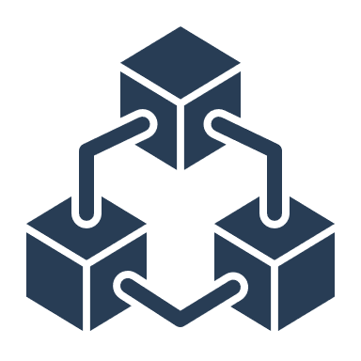




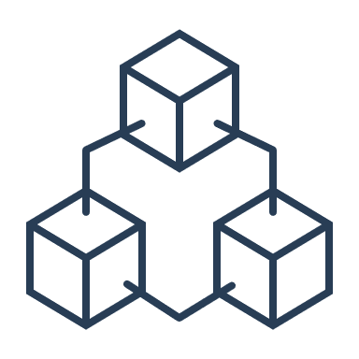

1. Bệnh nhân đăng ký khám
2. Bệnh viện tạo hồ sơ
bệnh nhân trên hệ thống.
6. Hệ thống chấp thuận &
Lưu EMR bệnh nhân vào hồ sơ
3. Bệnh nhân được thăm khám
bởi bác sĩ
5. Bác sĩ request lưu EMR
4. Bác sĩ tạo EMR bệnh nhân.

Slide 24
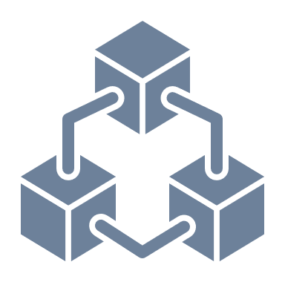
1. Bác sĩ gửi yêu cầu EMR
2. Hệ thống kiểm tra Adir của EMR
4. Lấy EMR và gửi cho bác sĩ.
3. Xác nhận đúng Adir

Slide 25



Yêu cầu EMR
Từ bệnh viện A
2. Bệnh viện tạo hồ sơ
bệnh nhân trên hệ thống.
Bác sĩ
bệnh viện N
6. Hệ thống chấp thuận &
Lưu EMR bệnh nhân vào hồ sơ
5. Bác sĩ request lưu EMR
4. Bác sĩ tạo EMR bệnh nhân.
3. Bệnh nhân được thăm khám
bởi bác sĩ

Slide 26
04
Conclusion
CSoNet 2023

Slide 27
Future works
Enhance system performance
Minimize latency and cost
Fortify the privacy and security measures surrounding medical data
Conclusion
Implement the system on a test network comprised of several blockchain platforms
Propose MIDAS system integrated Decentralized identity management solution, BIDI scheme, enhancing the capabilities of the healthcare by overcoming traditional barriers to data management and access

Slide 28

ICIT2023
Thank you for listening

